Slide 1

Data Analysis Essentials Cornerstone Project
Review 3
Web Based Product Tracking System
Presented by
R Thanuja (25B11AIA34)
G Akshaya (25B11AI328)
Y Aasmitha (25B11AID10)
Department of Artificial Intelligence & Machine Learning

Slide 2




Presentation Outline
Abstract
Introduction
Problem Statement
Dataset Details Before and After Cleaning
Missing Values and Duplicate Records
Coding Implementation with Step-by-Step Explanation
Expected Outputs and Actual Outputs
Accuracy Details
Prediction Models
Data Visualization
Conclusion

Slide 3
ABSTRACT
The Web Based Product Tracking System is a Python-based data analysis project designed to analyze e-commerce data and identify useful patterns. The project uses an e-commerce dataset from ExploreMyData and applies Python libraries such as Pandas, NumPy, Matplotlib, Requests, and BeautifulSoup for data collection, data cleaning, statistical analysis, and visualization.
The project performs data inspection, missing-value handling, duplicate removal, sorting, grouping, and aggregation. Different visualizations, including bar charts, pie charts, histograms, line charts, and box plots, are generated to understand the dataset. The cleaned data and numerical summaries are saved as CSV files for future reference. This project demonstrates how Python can be used to analyze and visualize e-commerce data effectively.

Slide 4
INTRODUCTION
E-commerce and product-order platforms generate records about orders, dates, customer or product identifiers, order status, item counts, prices, shipping, and totals, depending on the fields available in the source CSV. Reviewing large tables manually can make patterns and data-quality issues difficult to identify. Python libraries help organize this process: Requests retrieves the source files, BeautifulSoup reads page metadata and links, Pandas manages tabular data, NumPy performs numerical operations, and Matplotlib visualizes results.
This project applies these tools to an e-commerce sample dataset. It focuses on cleaning and understanding the records, summarizing available fields, and presenting patterns in charts. The conclusions are limited to the columns and records actually present in the downloaded file.

Slide 5
PROBLEM STATEMENT
The e-commerce dataset may contain many order records and attributes, including date-like, categorical, and numeric fields. Manual inspection is slow and can overlook missing values, repeated rows, inconsistent data types, or category imbalances. These issues can affect averages, counts, correlations, and charts.
The project therefore needs a repeatable workflow to retrieve the dataset, inspect its structure, identify missing and duplicate records, convert selected fields, fill missing values where appropriate, analyze the cleaned data, and communicate findings visually. The system must also distinguish descriptive analysis from prediction: the supplied code summarizes existing records but does not forecast future product demand or order outcomes.

Slide 6
DATASET DETAILS BEFORE AND
AFTER CLEANING
Dataset Before Cleaning
The project uses an e-commerce dataset in CSV format downloaded from a web-based source using the Python Requests library. The dataset is loaded into a Pandas DataFrame for inspection and analysis.
The following operations are performed to understand the original dataset:
df.head() displays the first five records.
df.tail() displays the last five records.
df.sample() displays five random records.
df.shape identifies the number of rows and columns.
df.columns displays the column names.
df.dtypes identifies the data type of each column.
df.describe(include="all") provides a statistical summary.
These operations help identify the dataset structure, data types, missing values, and duplicate records before cleaning.

Slide 7
DATASET DETAILS BEFORE AND
AFTER CLEANING
Dataset After Cleaning
The dataset is cleaned to improve its quality and consistency before analysis.
Duplicate records are removed using df.drop_duplicates().
Column names are converted to lowercase, and unnecessary spaces are removed.
Relevant date columns are converted into datetime format.
Price, amount, total, shipping, and other selected columns are converted into numeric format.
Missing numerical values are replaced with the median when valid numerical values exist.
Missing values in non-date, non-numeric columns are replaced with "Unknown".
The cleaned dataset is exported to cleaned_ecommerce_data.csv.
The cleaned dataset is more suitable for statistical analysis and visualization. The exact number of records before and after cleaning depends on the actual dataset.

Slide 8
MISSING VALUES AND DUPLICATE RECORDS
Missing-Value Detection
Missing values occur when information is unavailable in one or more dataset columns. They may affect calculations and the interpretation of results.
The statement df.isnull().sum() identifies the number of missing values in each column. The project handles these values according to the column data type.
Numerical columns: Missing values are replaced with the column median if valid numerical values are available.
Text columns: Missing values are replaced with "Unknown".
Date columns: Missing values are retained to avoid introducing incorrect dates.
After cleaning, df.isnull().sum() is executed again to check the remaining missing values.

Slide 9
MISSING VALUES AND DUPLICATE RECORDS
Duplicate-Record Removal
Duplicate records are repeated rows that may affect statistical calculations and data analysis.
The statement df.duplicated().sum() calculates the number of duplicate rows before cleaning.
The statement df.drop_duplicates().copy() removes duplicate rows and creates a copy of the cleaned dataset.
The program then checks the dataset shape and missing values again to examine the results of cleaning.
Duplicate records are removed, and missing values are handled according to the implemented rules. However, some missing values may remain in date columns or entirely empty numerical columns.

Slide 10
Coding Implementation with Step-by-Step Explanation
Data Collection and Inspection
The project uses Python libraries to retrieve, load, and inspect e-commerce data.
Step 1: Import libraries
Requests, Pandas, NumPy, Matplotlib, BeautifulSoup, and StringIO are imported for web requests, data processing, numerical operations, visualization, HTML parsing, and CSV loading.
Step 2: Extract website information
requests.get() retrieves the webpage, while BeautifulSoup extracts the website title and the first ten available links.
Step 3: Load the dataset
The e-commerce CSV file is downloaded and loaded into a Pandas DataFrame using pd.read_csv().
Step 4: Inspect the dataset
Functions such as head(), tail(), sample(), info(), and describe() are used to examine the data.

Slide 11
Coding Implementation with Step-by-Step Explanation
Data Cleaning and Analysis
Step 5: Clean the dataset
Duplicate rows are removed, relevant date and numerical columns are converted, and missing values are handled.
Step 6: Filter and sort records
The program selects columns, filters records above the mean of the first numerical column, and sorts records in descending order.
Step 7: Perform statistical analysis
The code calculates category frequencies, grouped averages, numerical aggregations, and correlations when suitable columns are available.
Step 8: Generate visualizations
Different charts are created to understand category distributions, numerical patterns, and relationships between variables.
Step 9: Save results
The cleaned dataset and numerical summary are exported to CSV files for future reference.

Slide 12
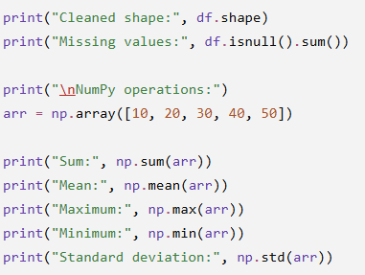
EXPECTED OUTPUTS
The project is expected to display website information, dataset records, statistical summaries, and data-cleaning results. It also performs numerical calculations and generates charts to support data analysis.
The main expected outputs are:
Website title and links.
Dataset records and dimensions.
Missing-value and duplicate counts.
NumPy calculations.
Cleaned dataset.
Filtered and sorted records.
Grouped averages and numerical
aggregations.
Correlation matrix.
Data visualization charts.
Cleaned CSV and numerical summary
files

Slide 13

ACTUAL OUTPUTS
The actual outputs are the values and charts produced when the Python program executes successfully in Google Colab or another Python environment.
The program displays dataset information, cleaning results, statistical calculations, and visualizations. It also saves cleaned_ecommerce_data.csv and, when numerical columns are available, numeric_summary.csv.
Actual record counts, missing values, and statistical values depend on the dataset downloaded during execution. Therefore, screenshots from the actual program should be included in the project report.

Slide 14
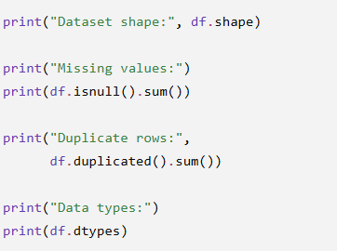
ACCURACY DETAILS
Data Quality and Reliability
The current project focuses on data cleaning and exploratory data analysis rather than machine-learning predictions. Its reliability is assessed by checking whether duplicate rows are removed, missing values are handled as intended, data types are converted correctly, and statistical calculations execute successfully.
The before-and-after dataset dimensions and missing-value counts help evaluate the results of preprocessing.
These checks help evaluate data quality, but they do not calculate a machine-learning accuracy score.

Slide 15
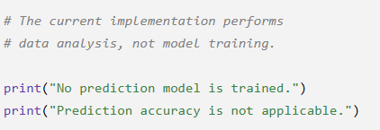
ACCURACY DETAILS
Prediction Accuracy
The current code does not train or test a prediction model. Therefore, prediction accuracy, precision, recall, and F1-score cannot be reported for this implementation.
If a prediction model is added in the future, its performance can be evaluated using a separate test dataset and suitable evaluation metrics.
For numerical predictions, metrics such as Mean Absolute Error (MAE), Root Mean Squared Error (RMSE), and R² can be used.
The current system evaluates data quality and patterns, not predictive accuracy

Slide 16
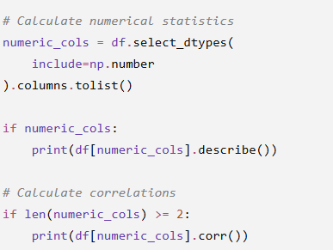
PREDICTION MODELS
Current Implementation
The existing system uses Pandas, NumPy, and statistical operations to analyze e-commerce data. It calculates averages, numerical summaries, category frequencies, and correlations between numerical columns.
These operations help identify patterns in the data, but they do not constitute a trained machine-learning model.
The monthly line chart displays the number of records for each month. It does not forecast future prices, sales, or product demand.

Slide 17
PREDICTION MODELS
Future Prediction Models
Machine-learning techniques could be added to extend the system's functionality.
Linear Regression: Could estimate numerical values, such as product prices or sales, using suitable features.
Time-Series Forecasting: Could forecast future sales or prices using sufficient historical data.
Decision Tree Regression: Could estimate numerical product-related values from relevant input features.
Classification Models: Could categorize products into predefined groups when suitable labelled data is available.
Before implementing these models, the project would require a clearly defined target variable, appropriate features, and separate training and testing datasets.

Slide 18
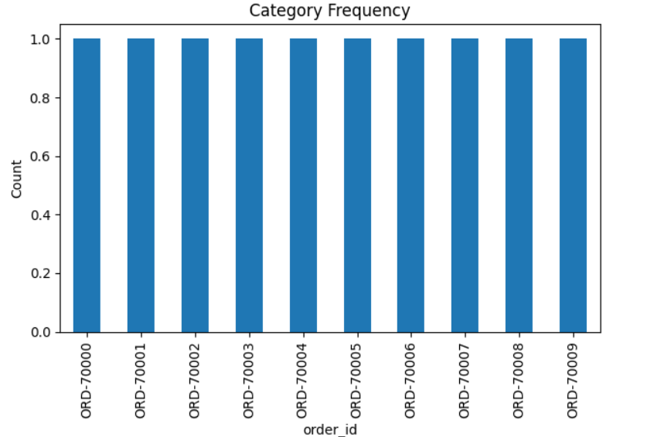
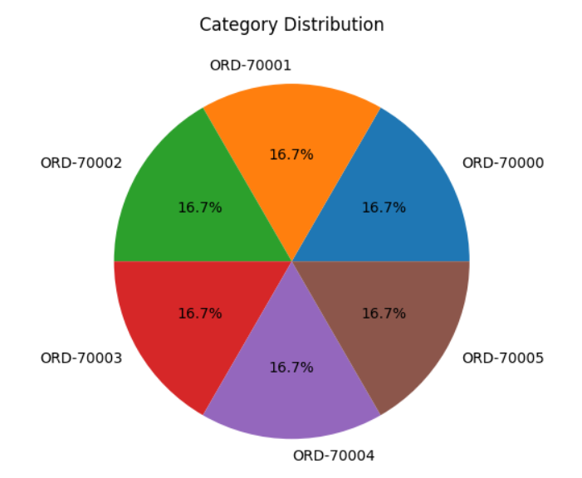
DATA VISUALIZATION
Bar Graph Pie Chart
This bar chart displays the frequency of each order ID in the dataset. Each order ID appears once in the displayed records, so every bar has a count of 1.
This pie chart shows the distribution of six order IDs. Each order ID represents approximately 16.7% of the displayed categories, indicating an equal share in this selection.

Slide 19
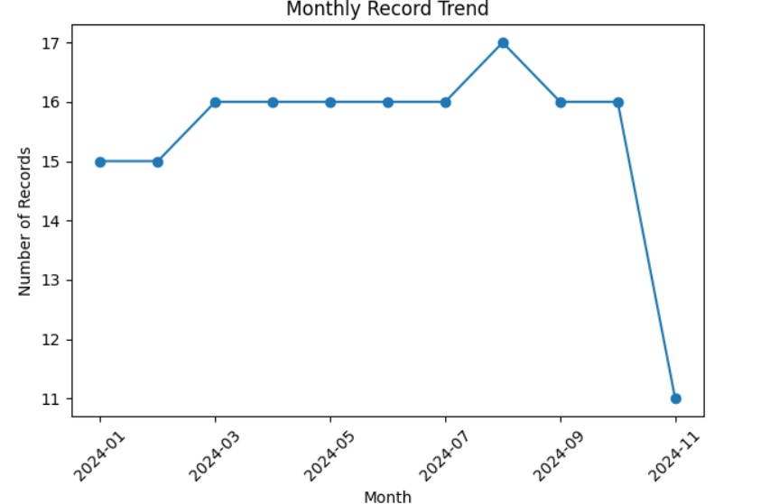
DATA VISUALIZATION
Histogram Line Chart
This line chart shows the number of records for each month in 2024. The number of records remains mostly between 15 and 17, reaches a peak of 17 in August, and decreases to 11 in November.

Slide 20
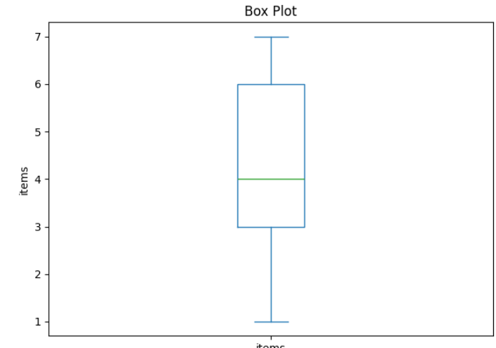
DATA VISUALIZATION
Box Plot Scatter Plot
This box plot represents the distribution of the items column. Values range from 1 to 7, with a median of 4 and the middle 50% of values between 3 and 6. No outliers are visibly displayed.

Slide 21
CONCLUSION
The Web-Based Product Tracking System demonstrates how Python can be used to collect, clean, process, and analyze e-commerce data. Pandas and NumPy support data manipulation and statistical analysis, while Matplotlib provides visual representations of the results.
The project handles duplicate records and selected missing values, converts relevant data types, performs filtering and aggregation, and generates charts to reveal patterns in the dataset. The cleaned data and numerical summary are saved as CSV files for further analysis.
Future enhancements could include live product-price monitoring, inventory tracking, automated data updates, and machine-learning-based forecasting.

Slide 22
THANK YOU

